Slide 1
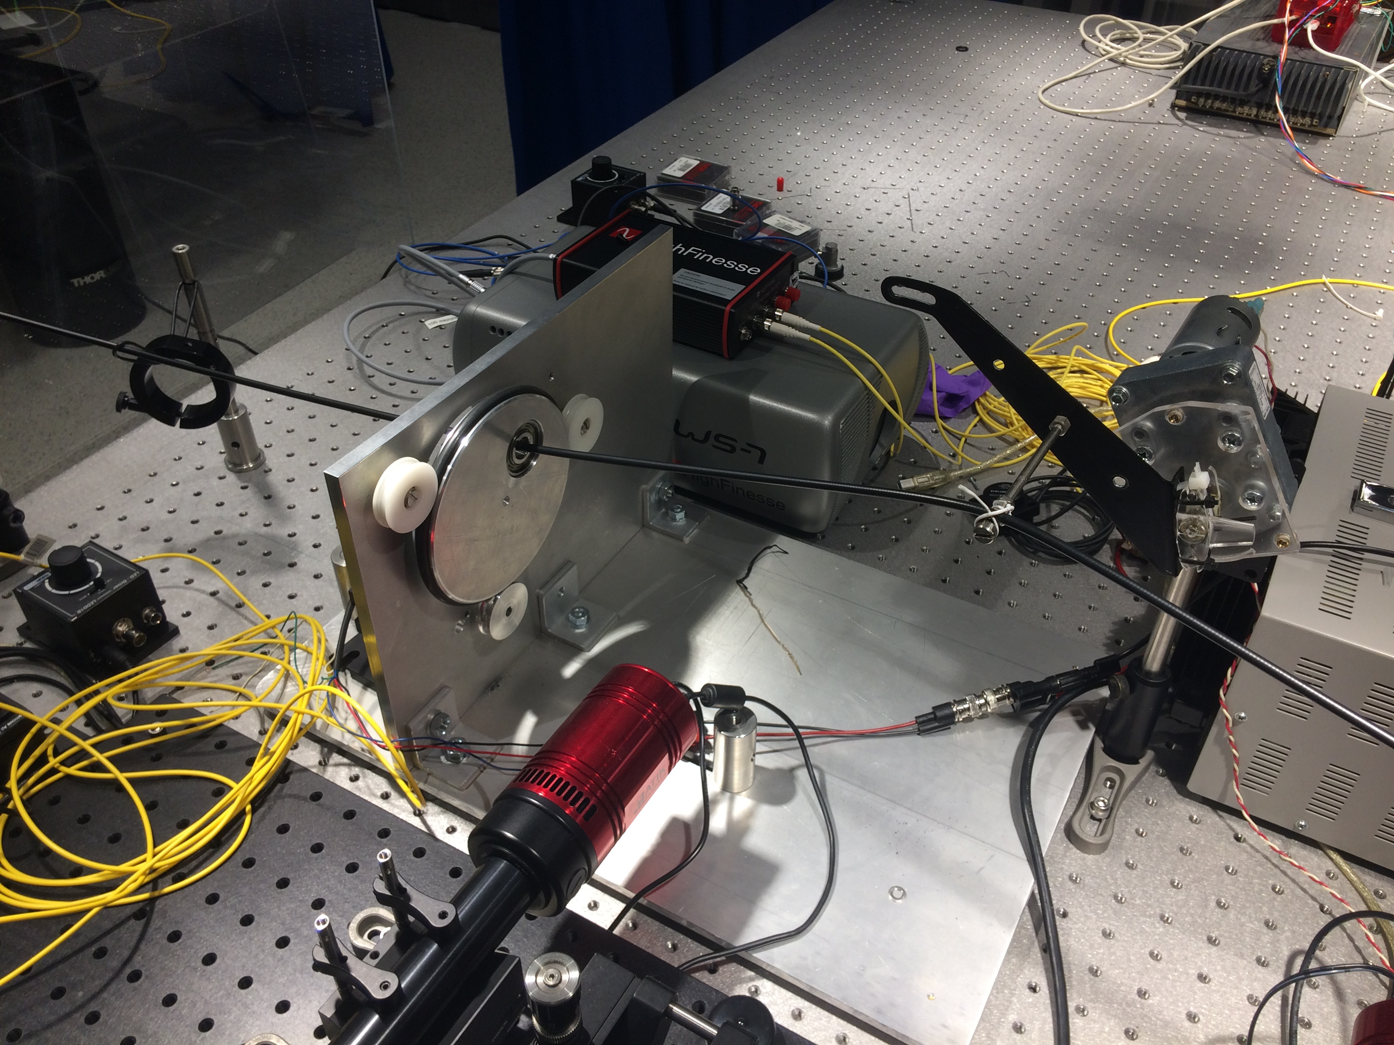
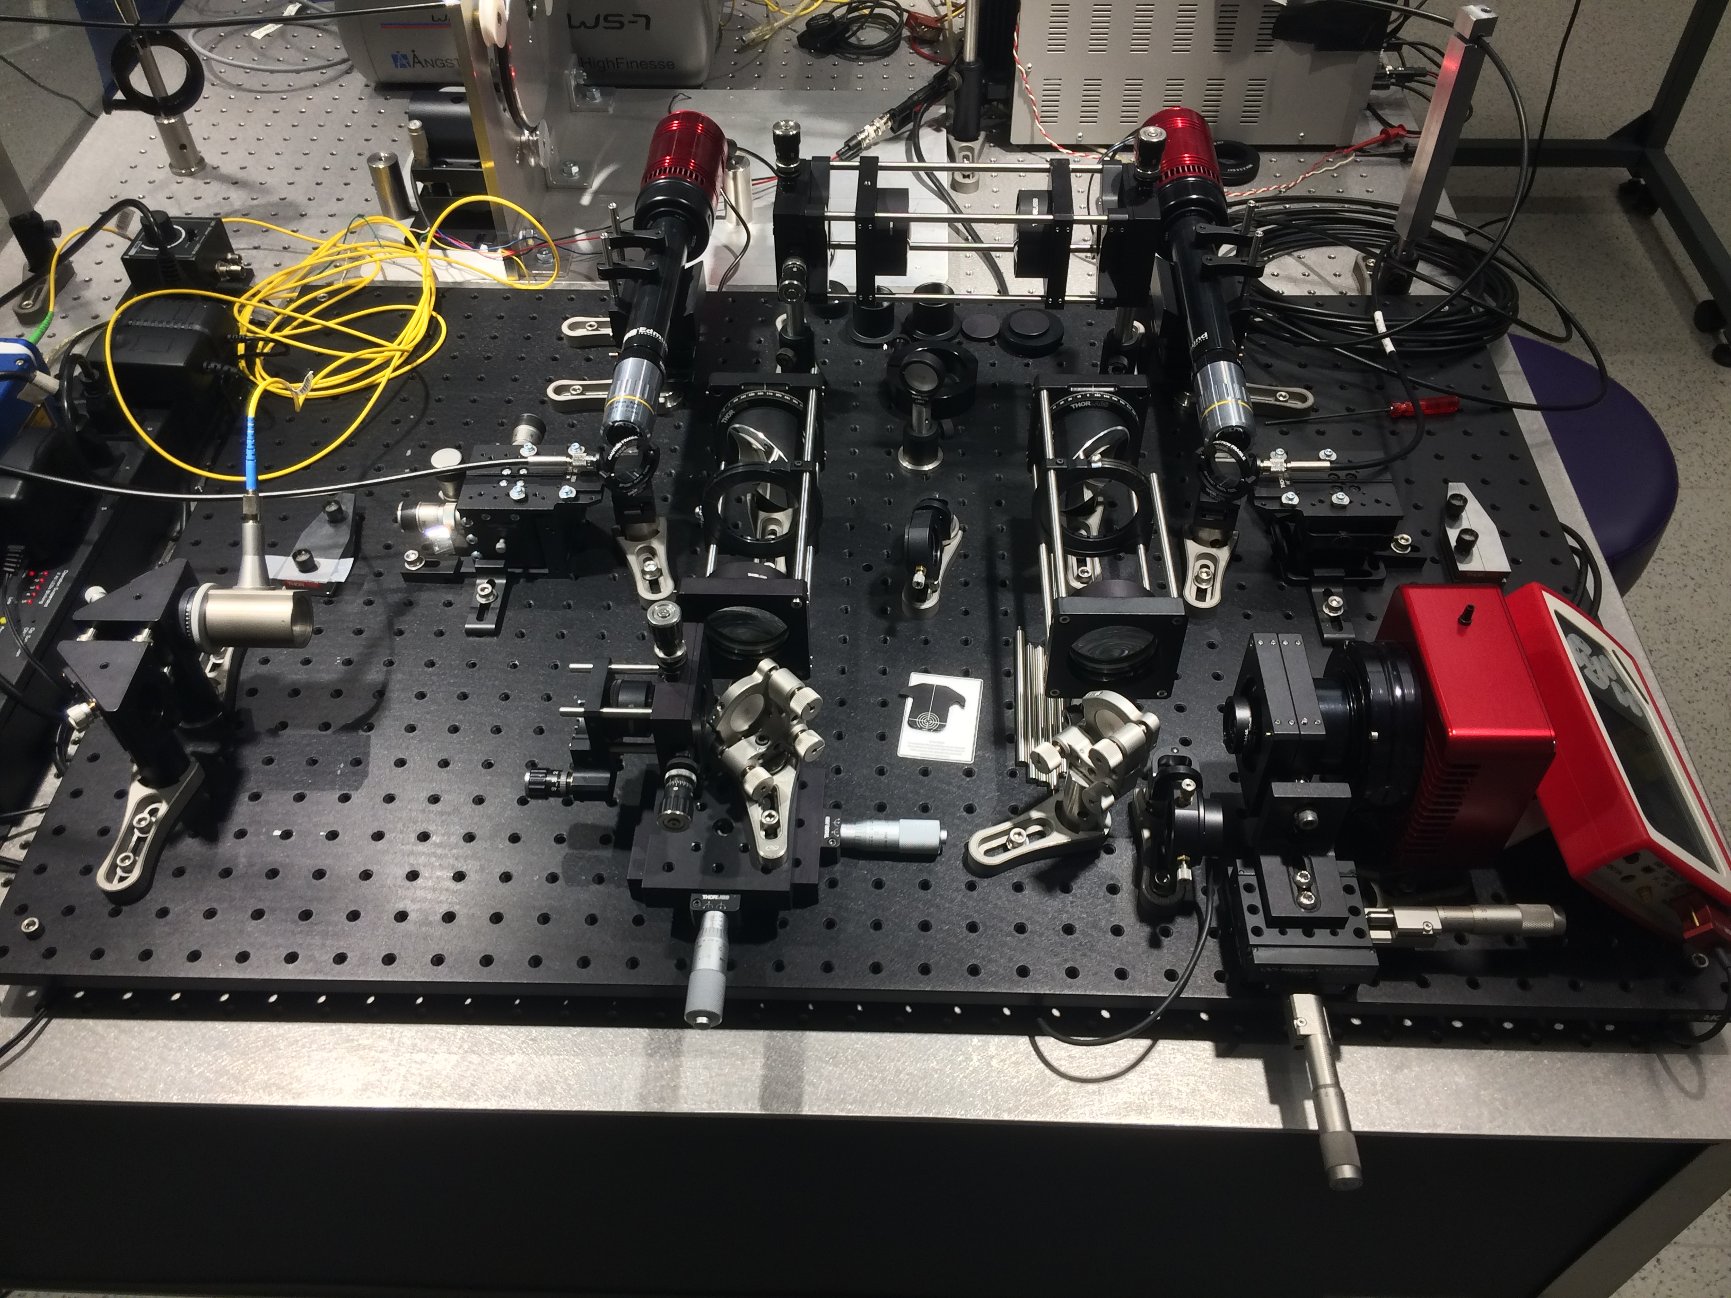
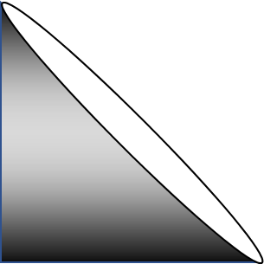
Counterweight
Circular Agitator
Linear Agitator
Rotating Arm
Agitation
Selection
Input
Near Field
10x
10x
Light Source Selection
Far Field

Slide 2
Tweeter
Linear
Circular
Agitation
Selection
Input
Near Field
10x
10x
Light Source Selection
Far Field

Slide 3
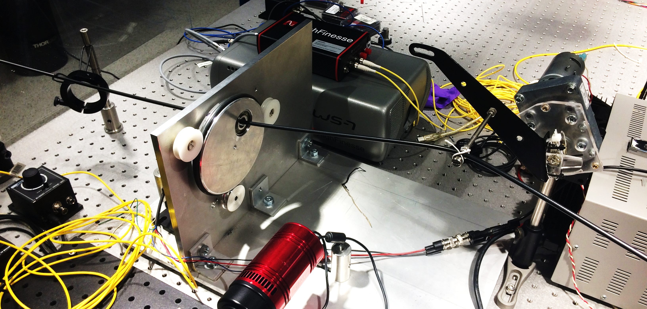
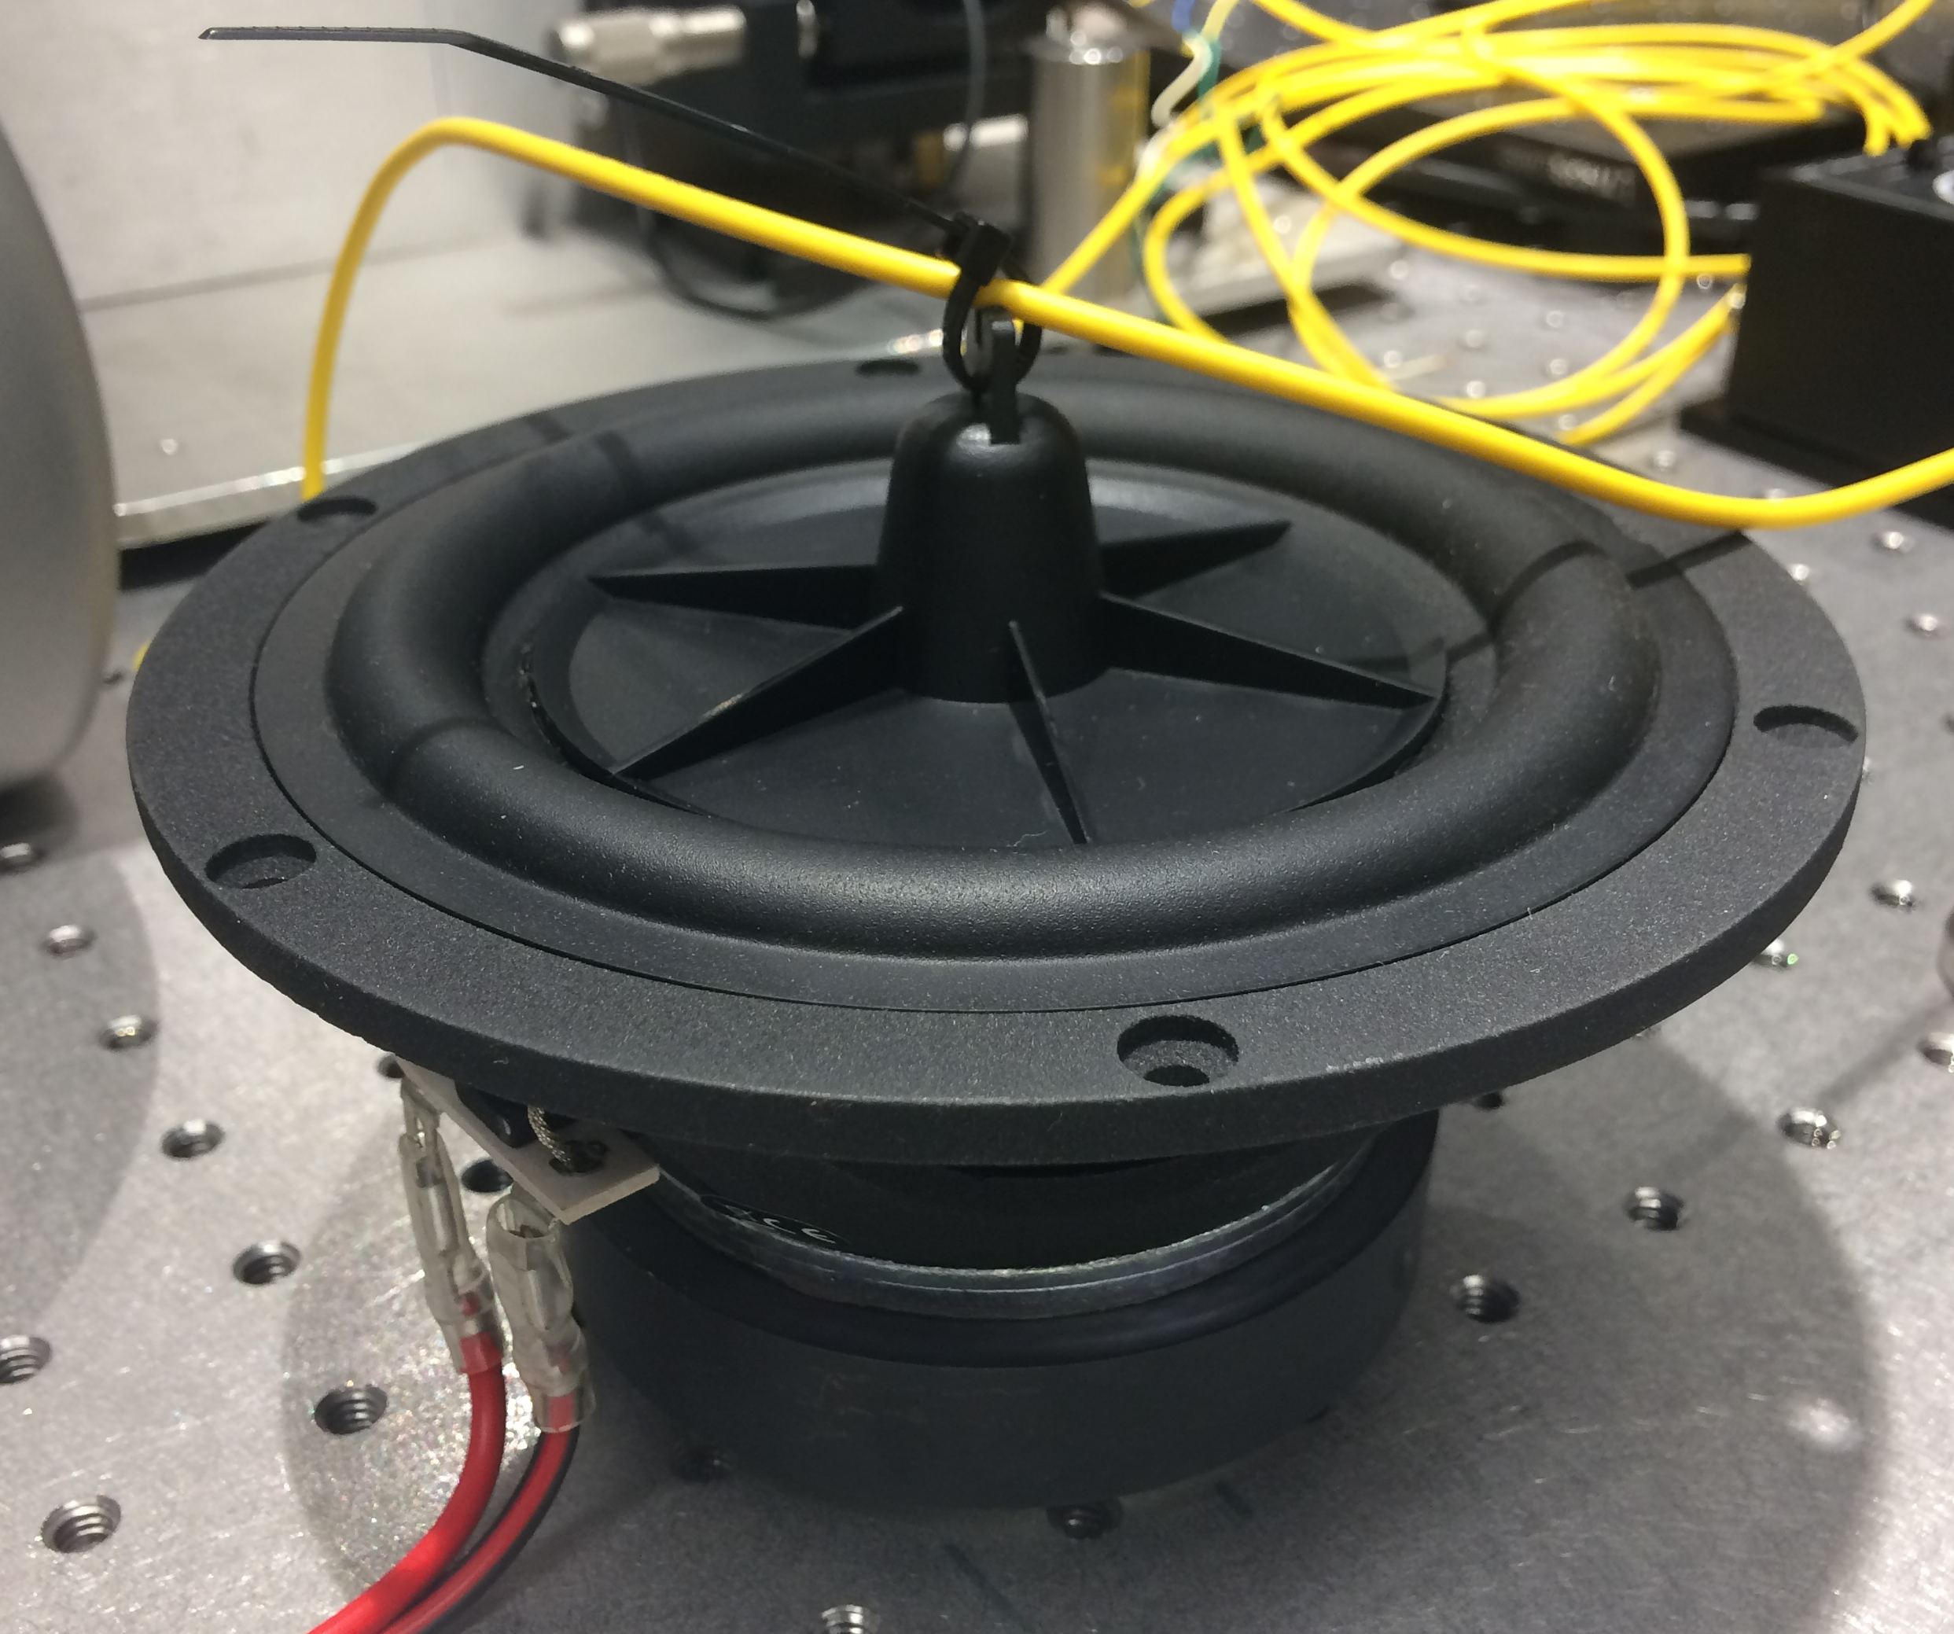
Counterweight
Linear Agitator
Circular Agitator
Rotating Arm
Tweeter
Optical Fiber

Slide 4
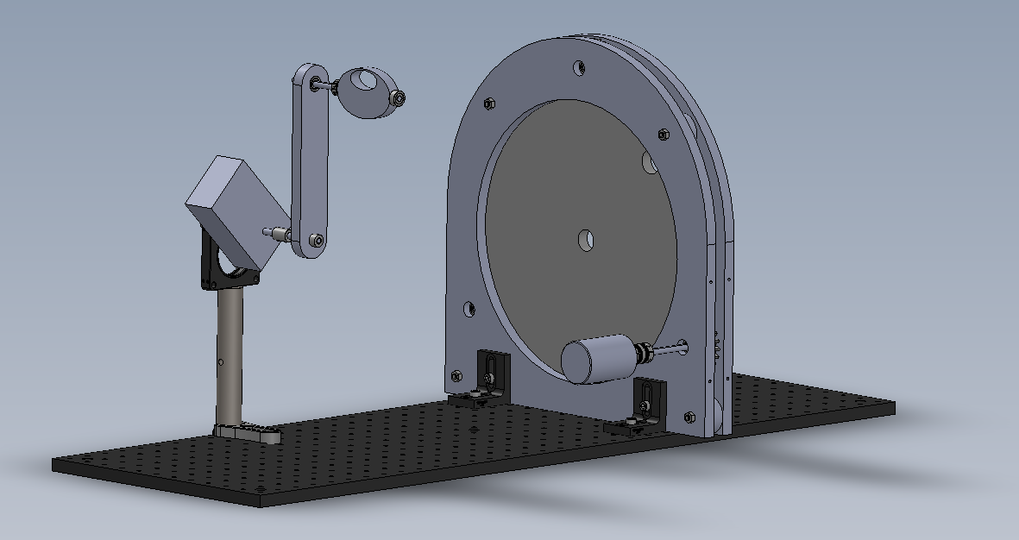
320 mm
Linear Agitator
320 mm
Circular Agitator

